Slide 1
CHAPTER 8: AFFILIATION AND OVERLAPPING SUBGROUPS
SOCIAL NETWORK ANALYSIS BY WASSERMAN AND FAUST
AFFILIATION NETWORKS
Adapted from a presentation by Jody Schmid and Anna Ryan
Sai Moturu

Slide 2
Basics

Slide 3
Introduction
Traditional social science studies look at the attributes of individuals (monadic attributes)
Eg: Age, Gender, Income
Network analysis studies the attributes of pairs of individuals (dyadic attributes)
Eg: Kinship (brother of, child of)
Eg: Actions (talks to, plays with)
Eg: Co-occurrence (has the same color eyes, lives in same neighborhood)
Eg: Mathematics (is two links removed from)
Notes:
Examples from http://www.analytictech.com/networks/whatis.htm

Slide 4
Affiliation Networks
Affiliation networks are two mode networks that allow one to study the dual perspectives of the actors and the events (unlike one mode networks which focus on only one of them at a time)
They look at collections or subsets of actors or subsets rather than ties between pairs of actors
Connections among members of one of the modes as based on linkages established through the second mode

Slide 5
Basics Notions
Multiple group affiliations are fundamental in defining the social identity of individuals
The social circle is an unobservable entity that must be inferred from behavioral similarities among collection of individuals
To be used in social network analysis, events (social occasions) must be collections of individuals whose membership is known, rather than inferred
A distinctive feature of affiliation networks is duality i.e. events can be described as collections of individuals affiliated with them and actors can be described as collections of events with which they are affiliated

Slide 6
Definitions
Events can be a wide range of social occasions
  Social clubs in a community
  University committees
  Boards of directors of major corporations
  Do not require face-to-face interactions among actors at a physical location and a particular point in time (e.g. IEEE members)
Co-occurence relations (one-mode ties)
  The relationship between actors is one of co-membership or co-attendance
  The relationship between events is one of overlapping or interlocking

Slide 7
Affiliation Networks are Relational
They show how actors and events are related
They show how events create ties among actors
They show how actors create ties among events

Slide 8
Benefits
Affiliations of actors with events provide a direct linkage between actors through memberships in events, or between events through common memberships
Affiliations provide conditions that facilitate the formation of pairwise ties between actors
Affiliations enable us to model the relationships between actors and events as a whole system

Slide 9
Representation

Slide 10
Representation
Many ways to represent affiliation networks:
  Affiliation network matrix
  Bipartite graph or Sociomatrix
  Hypergraph
  Simplicial Complex
Each of these representations contain exactly the same information, and, as a result, any one can be derived from the other
Methods to study affiliation networks are less well-developed than those to study one-mode networks. Hence, most of the discussion in this chapter is with respect to representation

Slide 11

Affiliation Network Matrix
Records the affiliation of each actor with each event in an affiliation metrix
There are g actors and h events
A is a g x h matrix
Each row describes an actor’s affiliation with the events and each column describes the membership of the event.

Slide 12
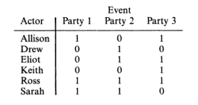
Example: Six Children - Three Parties
The actors are the children and the events are the birthday parties they attended
Row marginal totals indicate the number of parties a child attended
Column marginal totals indicate the number of children that attended a party

Slide 13
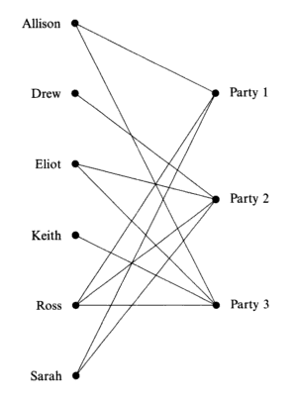
Bipartite Graph
Nodes are partitions into two subsets and all lines are between pairs of nodes belonging to different subsets
As there are g actors and h events, there are g + h nodes
The lines on the graph represent the relation “is affiliated with” from the perspective of the actor and the relation “has as a member” from the perspective of the event.
No two actors are adjacent and no two events are adjacent. If pairs of actors are reachable, it is only via paths containing one or more events. Similarly, if pairs of events are reachable, it is only via paths containing one or more actors.

Slide 14
Advantages and Disadvantages
Advantages
  They highlight the connectivity in the network, as well as the indirect chains of connection
  Data is not lost and we always know which individuals attended which events
Disadvantage
  They can be unwieldy when used to depict larger affiliation networks

Slide 15
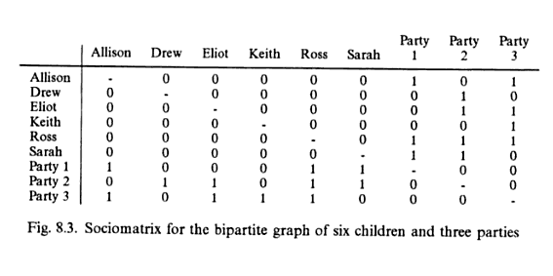
Bipartite Graph as a Sociomatrix
g = 6 children
h = 3 parties
g+h = 9 rows
g+h = 9 cols
The sociomatrix is the most efficient way to present information and is useful for data analytic purposes.

Slide 16
Advantages and Disadvantages
Advantage
  It allows the network to be examined from the perspective of an individual actor or an individual event because the actor’s affiliations and the event’s members are directly listed.
Disadvantage
  It can be unwieldy when used to depict large affiliation networks.

Slide 17
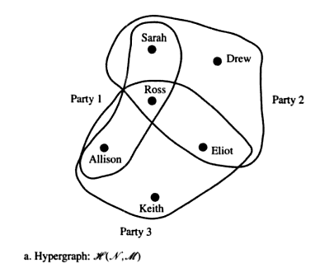
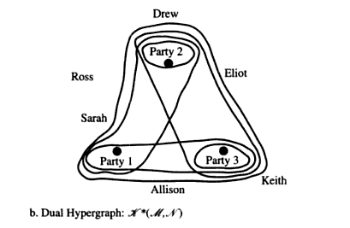
Hypergraph
Affiliation networks can also be described as collections of subsets of entities
Both actors and events can be viewed as subsets of entities
Hypergraphs consist of a set of objects, called points and a collection of subsets of objects, called edges
  Actors = points & Events = edges
  Events = points & Actors = edges

Slide 18
Advantages and Disadvantages
Advantage
  Allows the network to be examined from the perspective of an individual actor or an individual event because the actor’s affiliations and the event’s members are directly listed.
Disadvantage
  It can be unwieldy when used to depict large affiliation networks.
Hypergraphs have been used to describe urban structures and participation in voluntary organizations.

Slide 19
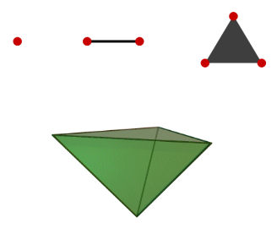
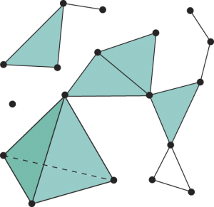
Simplicial Complexes
Represent affiliation networks using ideas from algebraic topology
More complex than hypergraphs
Useful for studying the overlaps among the subsets and the connectivity of the network
Can be used to define the dimensionality of the network in a precise mathematical way
Can be used to study the internal structure of the one-mode networks implied by the affiliation network by examining the degree of connectivity of entities in one mode, based on connections defined by the second mode
Notes:
Figures from http://tcsmath.wordpress.com/2008/12/19/lecture-8a-a-primer-on-simplicial-complexes-and-collapsibility/
It’s most intuitive to start with the geometric viewpoint, in which case an -simplex is defined to be the convex hull of affinely independent points in n+1 affinely independent points in R. These points are called the vertices of the simplex.
A simplicial complex is then a collection of simplices glued together along lower-dimensional simplices.

Slide 20
Properties

Slide 21
One-mode Networks
Substantive applications of affiliation networks focus on just one of the modes
Such one mode analyses use matrices derived from the affiliation matrix of the graphs defined by such matrices
The affiliation network data is processed to give the ties between pairs of entities in one mode based on the linkages implied by the second mode

Slide 22
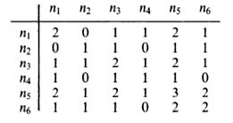

Co-membership and Overlap

Slide 23
Properties of Actors and Events
Rates of participation: the number of events with which each actor is affiliated
Size of events: the number of actors affiliated with each event

Slide 24
Properties of One-mode Networks
Density
Reachability, Connectedness and Diameter
Cohesive Subsets of Actors or Events
Reachability for Pairs of Actors

Slide 25
Pairwise Ties
The number of overlap ties between events is, in part, a function of the number of events to which actors belong.
The number of co-membership ties between actors is, in part, a function of the size of events
An actor who belongs to a_{i} events creates a_{i}(a_{i}-1)/2 pairwise ties between events
An event with a_{j} members creates a_{j} (a_{j}-1)/2 pairwise ties between pairs of actors
Rates of membership for actors and size of events influence number of ties

Slide 26
Density
Density is a function of the pairwise ties between actors or between events
Density of a relation is the mean of the values of the pairwise ties
For a dichotomous relation , density is the proportion of ties that are present.
For a valued relation, density is the average value of the ties.
Notes:
Dichotomous relation – no values, only presence or absence

Slide 27
Reachability, Connectedness & Diameter
Reachability can be studied using a bipartite graph, with both actors and events represented as nodes
In a bipartite graph, no two actors are adjacent and no two events are adjacent
  If pairs of actors are reachable, it is only via paths containing one or more events
  Similarly, if pairs of events are reachable, it is only via paths containing one or more actors
One could analyze the sociomatrix representing the bipartite graph to see whether all pairs of nodes are reachable
Diameter (length of the longest path between pairs of actors/events) and connectedness can also be studied similarly
Connectedness and reachability can also be studied from the affiliation matrix

Slide 28
Cohesive subsets of actors or events
A clique is a maximal complete subgraph of three or more nodes
In a valued graph, a clique at level c is a maximal complete subgraph of three or more nodes, all of which are adjacent at level c i.e. all pairs of nodes have lines between them with values greater than or equal to c
We can locate more cohesive subgroups by successively increasing the value of c.
For the co-membership relation for actors, a clique at level c is a subgraph in which all pairs of actors share memberships in no fewer than c events.
For the overlap relation for events: a clique at level c is a subgraph in which all pairs of events share at least c members.

Slide 29
Reachability for Pairs of Actors
An alternative way to study cohesive subgroups in valued graphs is to use ideas of connectedness for valued graphs
The goal is to describe subsets of actors, all of whom are connected at some minimum level, c
Two nodes are c-connected (or reachable at level c) if there is a path between them in which all lines have a value of no less than c
Cohesive subgroups can be studied based on levels of reachability either among actors in the co-membership relation or among events in the overlap relation

Slide 30
Taking Account of Subgroup Size
Both the co-membership relation for actors and the overlap relation for events in one-node networks that are derived from an affiliation network are based on frequency counts.
As a result, the frequency of co-memberships for a pair of actors can be large if both actors are affiliated with many events, regardless of whether or not these actors are “attracted” to each other.
This is also true for events in that the overlap between events may be large because they include many members even if they do not “appeal to” the same kinds of actors.
Some authors argue that it is important to standardize or normalize the frequencies to study the pattern of interactions.

Slide 31
Approaches
Odds ratio: One measure of event overlap that is not dependent on the size of events is the odds ratio. If the odds ratio is greater than 1, then actors in one event tend to also be in the other, and vice versa.
Bonacich (1972) proposed a measure, which is analogous to the number of actors who would belong to both events, if all events had the same number of members and non-members.
Faust and Romney (1985) normalize the matrix for actors and events so that all row and column totals are equal. This is equivalent to allowing all actors to have the same number of co-memberships or all events to have the same number of overlaps.

Slide 32
Simultaneous Analysis

Slide 33
Issues
The representation of two-mode data should facilitate the visualization of three kinds of patterning:
  the actor-event structure
  the actor-actor structure
  the event-event structure
Simplicial complexes and hypergraphs provide two images – one shows how actors are linked to each other in terms of events and the other how events are linked in terms of their actors. However, neither image provides an overall picture of the total actor-actor, event-event, and actor-event structure.
Bipartite graphs provide a single-image for two mode data, but only display the actor-event structure. They do not provide a clear image of the linkages among actors or among events.

Slide 34
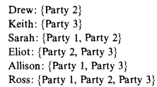
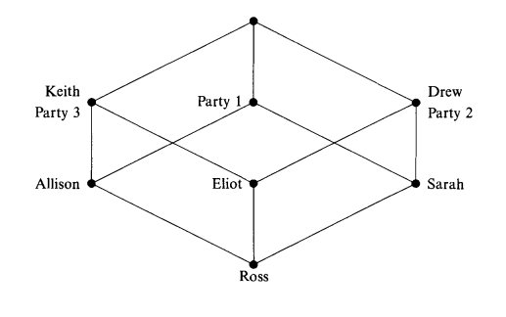
Galois Lattices
Galois lattices meet all three requirements in a clear, visual model.
Each point represents both a subset of actors and events
Reading from the bottom to top, there is a line or sequence of lines ascending from a child to a party that he attended
Reading from top to bottom, there is a line or sequence of lines descending from a party to the children that attended it
Notes:
Topmost point – all children and no parties

Slide 35
Advantages and Disadvantages
Advantages:
  Focus on subsets
  The display of complementary relationships between the actors and the events
Disadvantages:
  The visual display may become complex as the number of actors and/or events becomes large
  There is no unique best visual. The vertical dimension represents degrees of subset inclusion relationships among points, but the horizontal dimension is arbitrary. As a result, constructing good measures is somewhat of an art
  Unlike graph theory, properties and analyses of Galois lattices are not at all well developed
Unlike a graph which uses properties and concepts from graph theory to analyze a network, these properties of Galois lattices are not well developed.

Slide 36
Correspondence Analysis
Correspondence analysis is a method for representing both the rows and columns of a two-mode matrix results in a map where:
  Points representing the people are placed together if they attended mostly the same events.
  Points representing the events are placed close together if they were attended by mostly the same people.
  People-points and event-points are placed close together if those people attended those events.
Correspondence analysis includes an adjustment for marginal effects. As a result, people are placed close to events to the extent that
  these events were attended by few other people
  those people attended few other events.
Using reciprocal averaging, a score for a given row is the weighted average of the scores for the columns, where the weights are the relative frequencies of the cells.

Slide 37
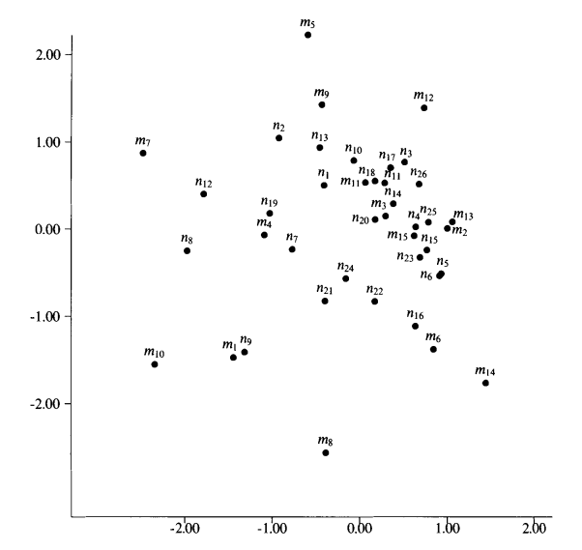
Example

Slide 38
Advantages and Disadvantages
Advantage
  It allows the researcher to study the correlation between the scores for the rows and the columns.
Disadvantages
  The data values have a limited range. As a result, they are difficult to fit using a continuous distance model of low dimensionality. Two-dimensional maps are almost always severely inaccurate and misleading.
  It is designed to model frequency data. The numbers do not represent distances and there is no way on a two-dimensional map to determine who attended what events.
  Distances are not Euclidean, yet human users often interpret them that way.

Slide 39
THE END

Slide 40
THANK YOU
Next Week: Blockmodels by Shamanth

